Slide 1

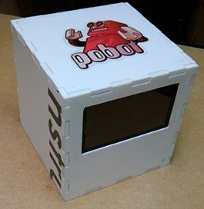
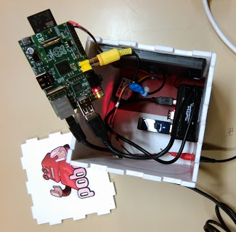
# Le Cube Media
A public service project
Open source & open hardware
#LeCubeMedia - février 2014
Presentation : Julien Holtzer– Creative Commons NC-BY-ND

Slide 2
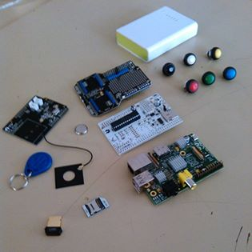
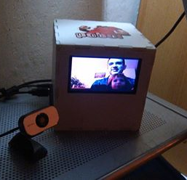
A Quick Definition
A communication and multimedia device
For every collaborative workspace or area
To automate repetitive tasks
#LeCubeMedia - février 2014

Slide 3
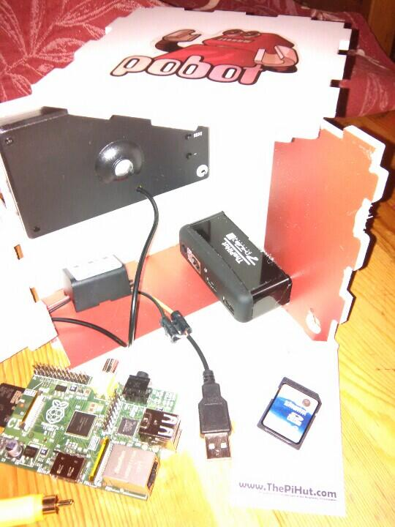
A Communication Device
Sturdier than a smartphone
PVC Cube
Flexible screen
Simple but firm buttons
With multiple connections
Bluetooth / BLE / Bluetooth 4.0
Wifi 802.11N + Access Point
ZigBee 802.15.4 : mesh network M2M
NFC tag reader & smartphones
#LeCubeMedia - février 2014
Notes:
<number>

Slide 4
Multimedia
Capable of storing all types of files
Sorted and referenced documents
Source code : local GIT, GitLab server
Free format videos, photos and sounds + conversions
Search engine for mixed contents
Capable of reading and recording data streams
For internal storage
For transmission/publication
Webcams, Pi camera, wifi-enabled lens (ex: Sony QX-10)
#LeCubeMedia - février 2014

Slide 5
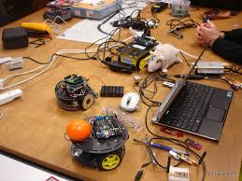
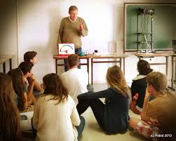
For Collaborative Workspace
Fixed
Project team offices
Co-working spaces
Fab Lab/makerspaces
Mobile
Workshops in institutions
Expositions, conferences
#LeCubeMedia - février 2014

Slide 6
Application 1: Multimedia Automation
6
#LCM
3
webcam
wifi
tablette
1
2
4
5
1
The webcam is connected : the Cube detects immediately the device
2
The broadcast is automatically started on the webcam
3
A DNS-SD service is declared on the local network
4
A Wi-Fi terminal detects the service and identifies the IP address and the port
5
The screen displays the webcam video and the selection options (touchscreen, voice)
6
The recording starts automatically and sort the streams accordingly
#LeCubeMedia - février 2014

Slide 7
Application 2: Activity Recording
1
2
3
4
4
2
3
4
5
6
1
I enter a collaborative workspace : I identify myself using a badge (an ID)
2
I choose a project and I tap its NFC tag on the Cube to change my activity
3
A sensor detects the use of a device or tool and starts video recording
4
I commit the source code: the Cube saves the code related to the project
5
I upload a video on Youtube, I post a tweet: the Cube saves the contents
6
I leave a Wi-Fi zone: the Cube ends the recording for all the projects tagged/activated
#LeCubeMedia - février 2014

Slide 8
Application 3: Multimodal Restoration
1
1
1
2
1
1
3
1
Collaborators work on the same project but not at the same time: every event and content is stored and associated with a project and N people.
Exposition: I start the Cube in presentation mode. All contents are read automatically as soon as I touch the NFC tag of a project to it.
I alternate between different projects and the photos or videos change according to the ID presented.
2
Documentation: several months have passed, we gather for a « docathon » a few people who go back over event history, saved and presented by the Cube in an interface that allows the cross-reference of source code, docs, photos, and videos with a list of people who worked on a certain project.
3
#LeCubeMedia - février 2014

Slide 9
Application 4: Service Management
Participating in a collaborative platform involves providing expertise or skills, availability and ideas, and finding in return services , means, and other available people with the same interest.
Following initial professional experiences a question arises regarding the measurement of what is brought and what is consumed in the interest of logistics, anticipating our needs, and collaborative space development and growth as well as regulating and assessing equity.
With the Cube Media, this measurement focuses on the sequence of tasks done by users with NFC tags, the usage of smartphones, sensors/stoppage of a machine tool, on vending machines, perhaps even the flow of input/output in RFID cabinets and shelves.
Automation provides a more reliable measurement and especially less tiresome in daily activities in order to make sure that everything concerning the resources and other assets of a project is handled properly, without constraint, and that it doesn't disrupt the way the collaborators work that might affect their efficiency and potential.
#LeCubeMedia - février 2014

Slide 10
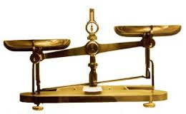
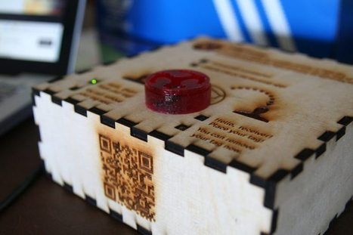
Connected Object n°2 :
The Roberval Scale: two NFC readers that identify a receiving card and a communicating card as well as the amount for a transaction in a service provided or consumed.
To be with linked with another initiative: Fab Money
#LeCubeMedia - février 2014

